Slide 1



Slide 2
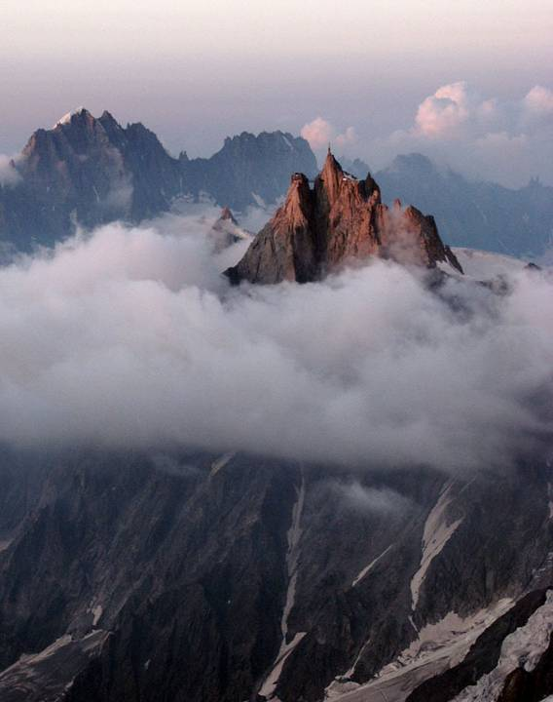
The Aiguille du Midi (3,842 m) is a mountain in the Mont Blanc Massif in the
French Alps.

Slide 3
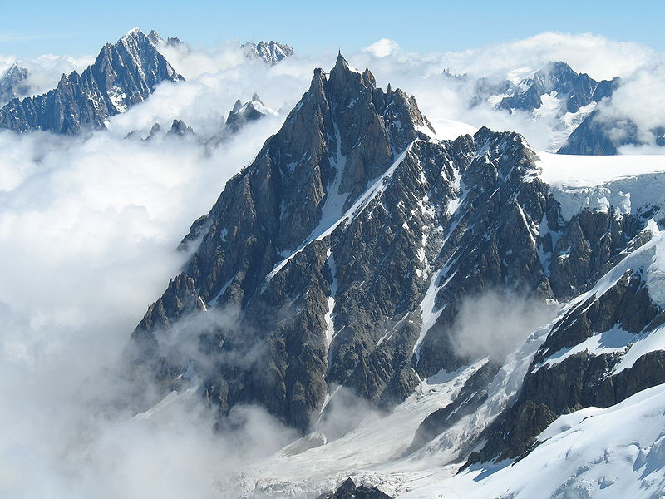

Slide 4
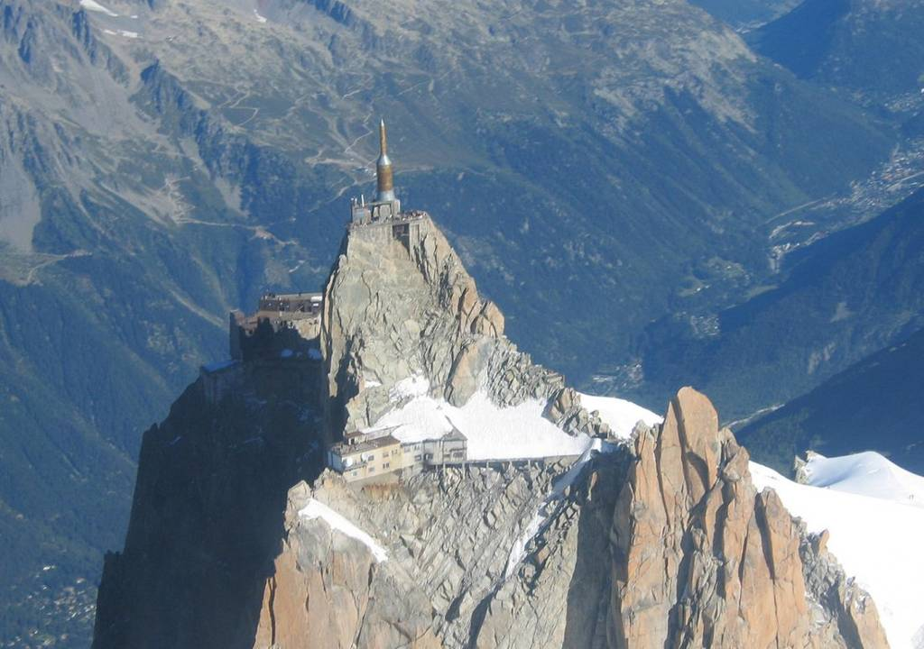

Slide 5
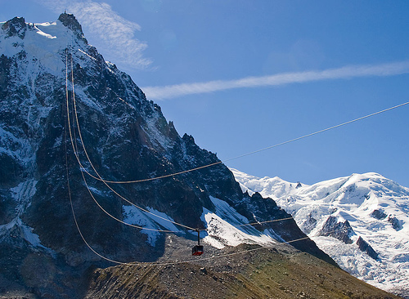

Slide 6
The cable car to the summit, the Téléphérique de l'Aiguille du Midi, was built in 1955 and held the title of the world's highest cable car for about two decades. It still holds the record as the highest vertical ascent cable car in the world, from 1,035 m to 3,842 m. There are two sections: from Chamonix to Plan de l'Aiguille at 2,317 m and then directly, without any support pillar, to the upper station at 3,777 m (the building contains an elevator to the summit). The span of the second section is 2,867 m measured directly, but only 2,500 m measured horizontally. It thus still is the the second longest span width, measured directly. The tramway travels from Chamonix to the top of the Aiguille du Midi – an altitude gain of over 2,800 m – in 20 minutes. An adult ticket from Chamonix (as of December 26, 2009) is €41 return.

Slide 7
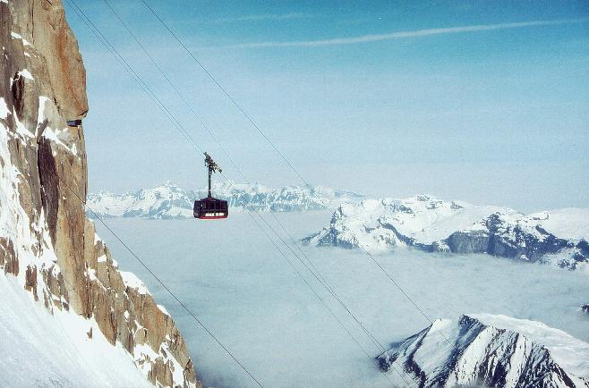

Slide 8
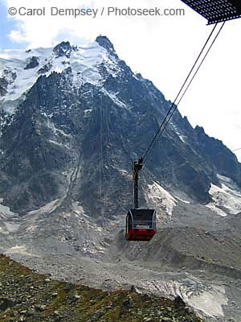
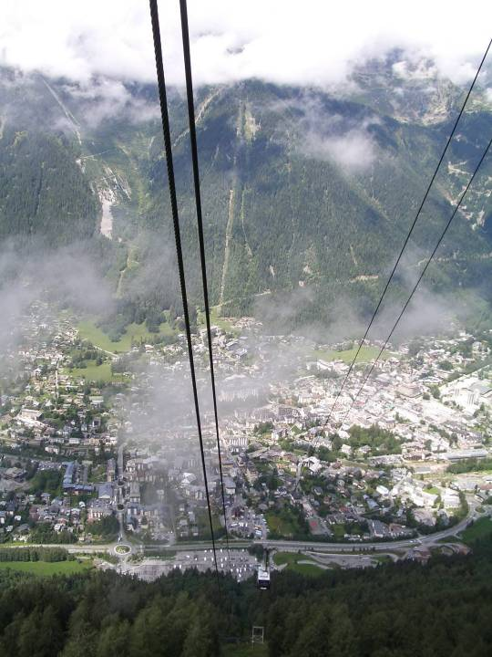

Slide 9
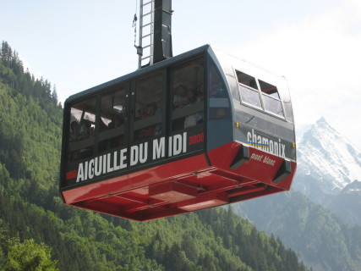

Slide 10
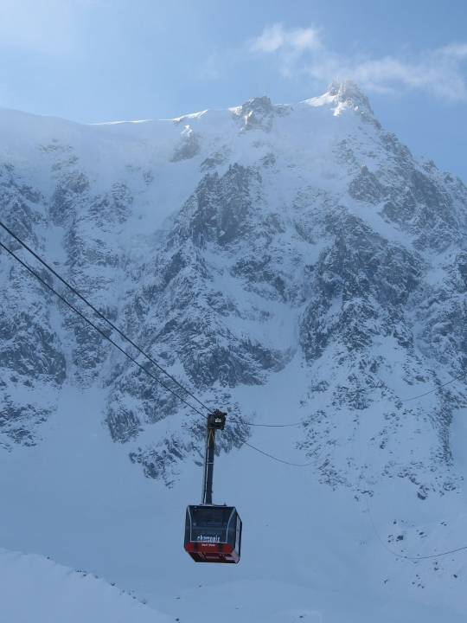
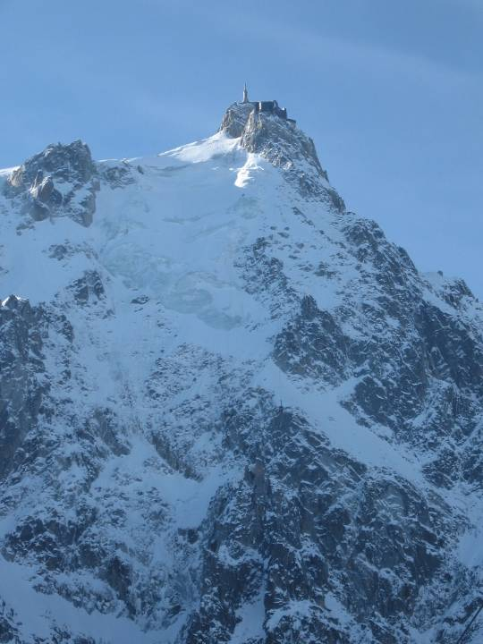

Slide 11
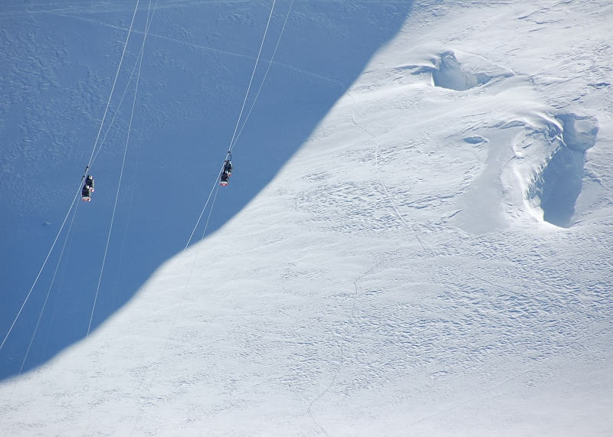

Slide 12
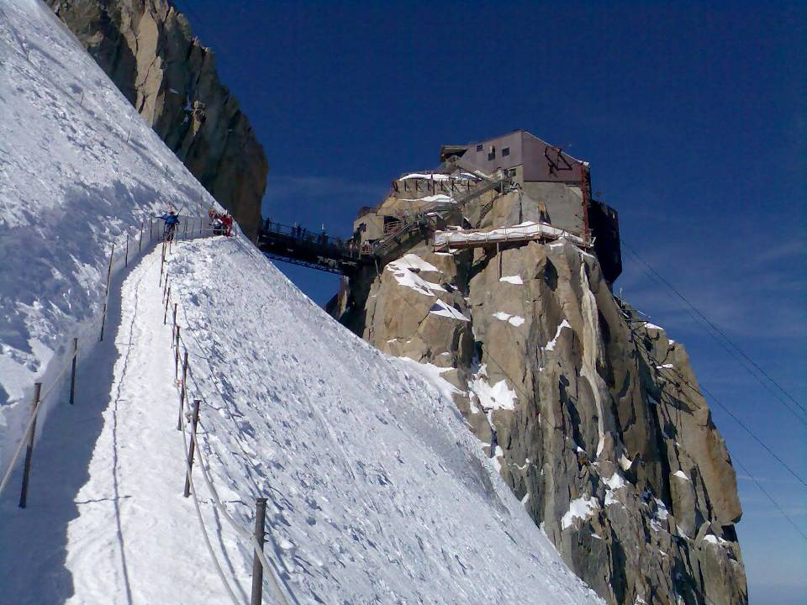

Slide 13
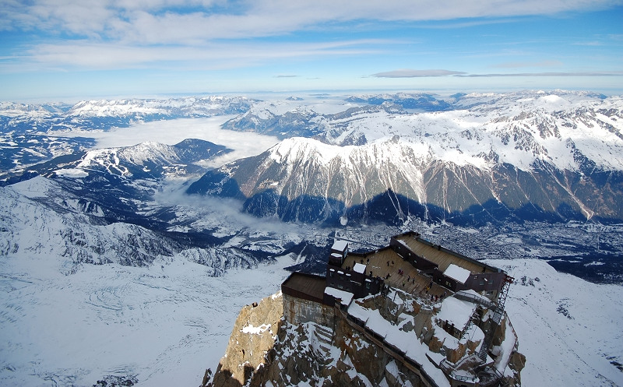

Slide 14
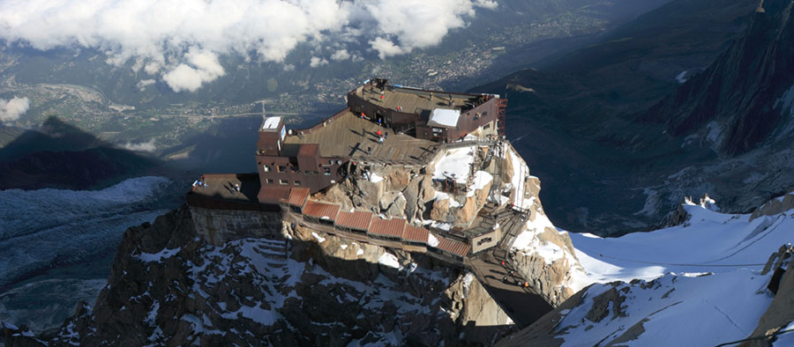
The Aiguille summit contains a panoramic
viewing platform, a cafe and a gift shop.

Slide 15
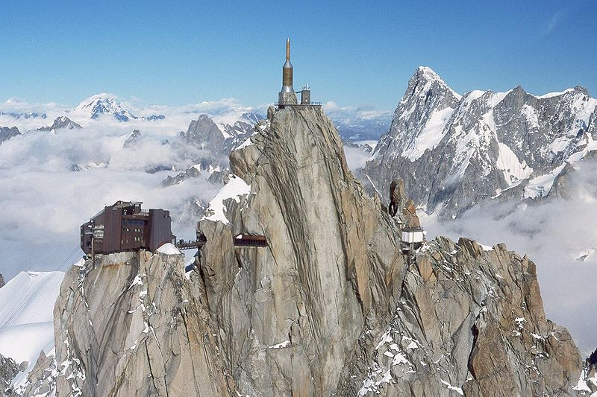

Slide 16
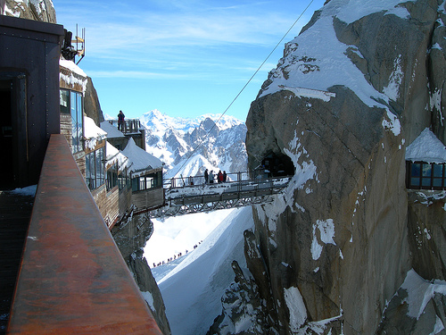

Slide 17
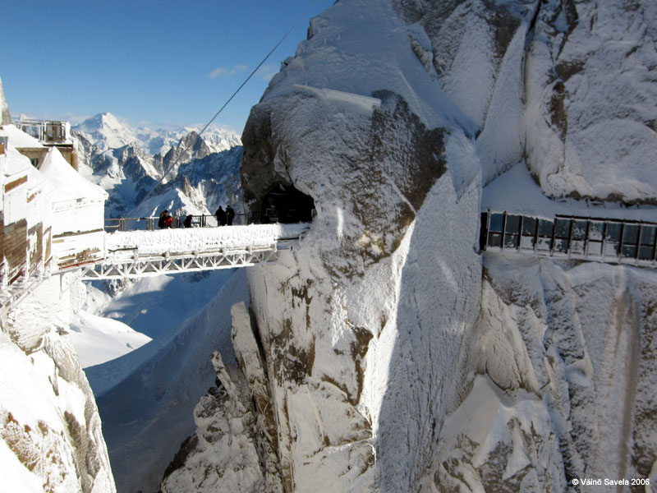

Slide 18
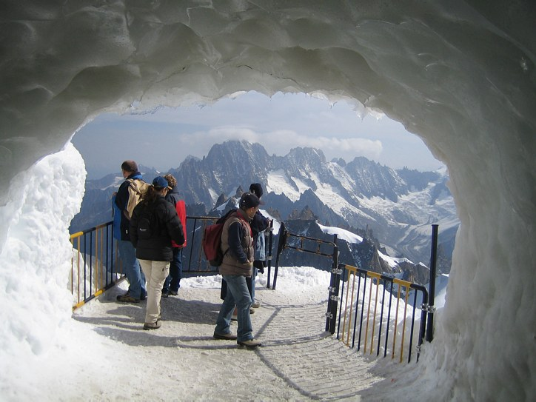

Slide 19
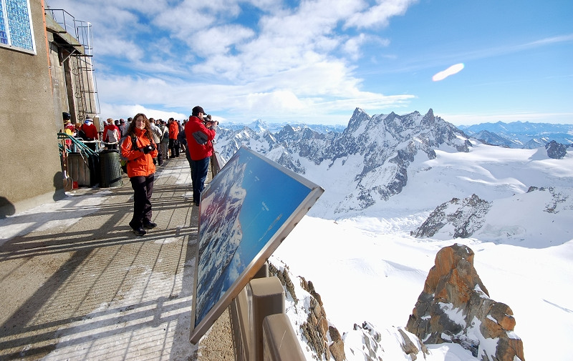

Slide 20
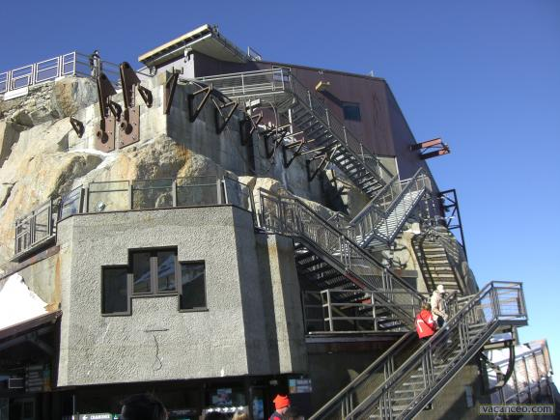

Slide 21
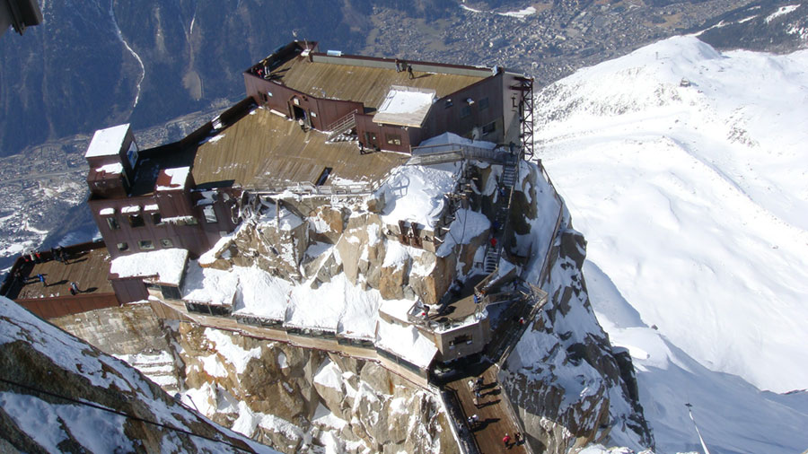

Slide 22
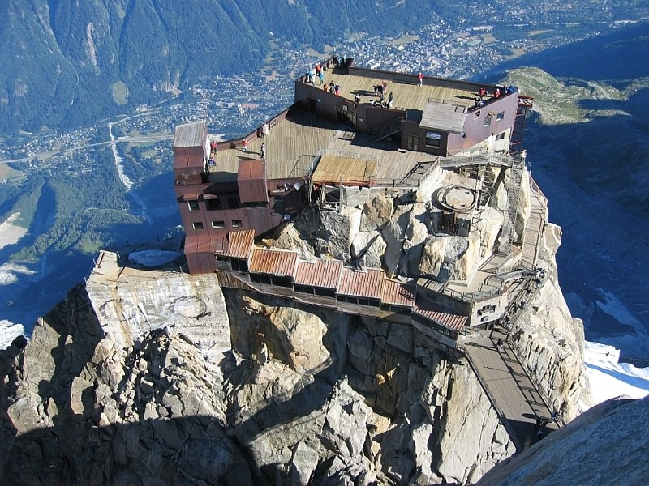

Slide 23
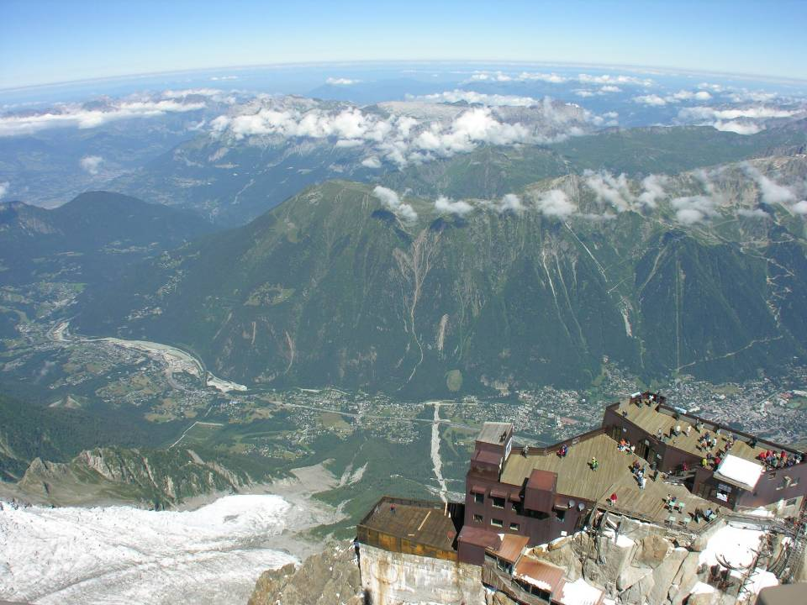
Valle de Chamonix - Francia

Slide 24
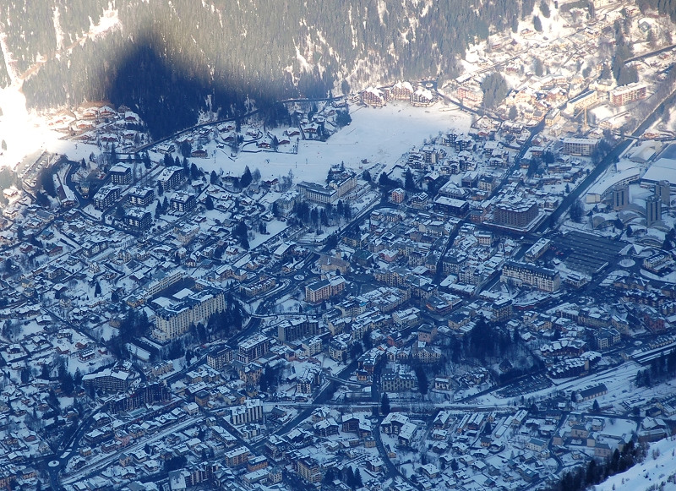

Slide 25
The Vallée Blanche ski run begins here, and the nearby Cosmiques Refuge is the starting point for one of the routes to the Mont Blanc summit. From the Aiguille another cable car (summer months only), the Vallee Blanche Aerial Tramway crosses the Glacier du Geant to Pointe Helbronner (3,462 m) at the Italian side of the Mont Blanc Massif. Pointe Helbronner is served with a cable car from La Palud, a village near Courmayeur in the Aosta Valley (Italy).
The name "Aiguille du Midi" translates literally as "needle of midday". It is so called as the sun sits directly over the peak at noon, when viewed from Chamonix.

Slide 26
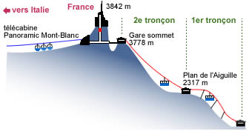

Slide 27
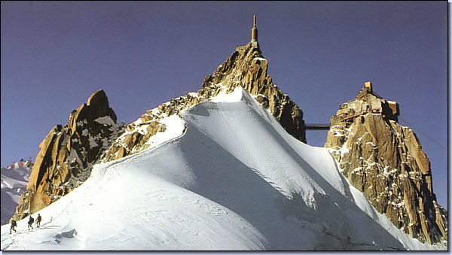

Slide 28
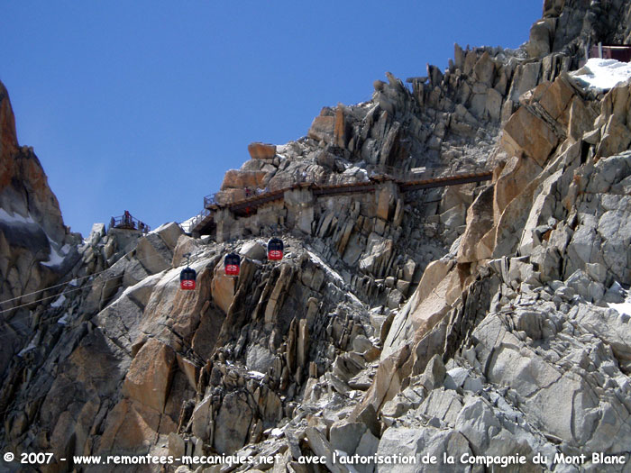
Telecabina panorámica

Slide 29
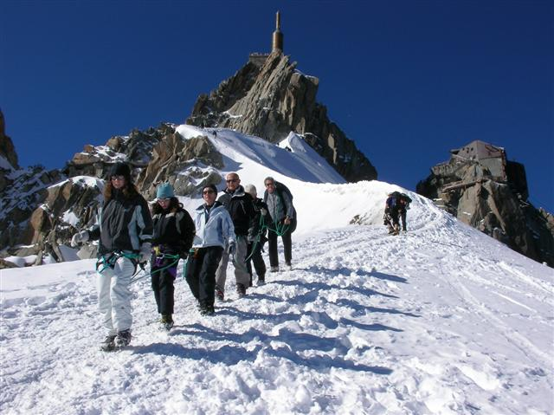

Slide 30
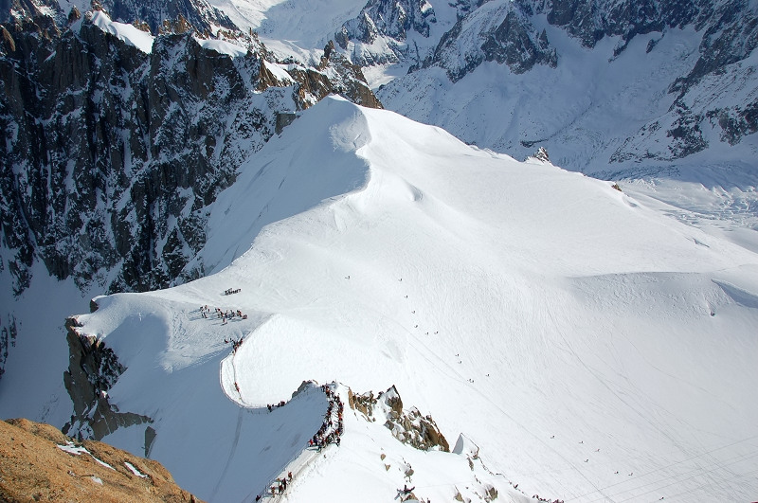

Slide 31
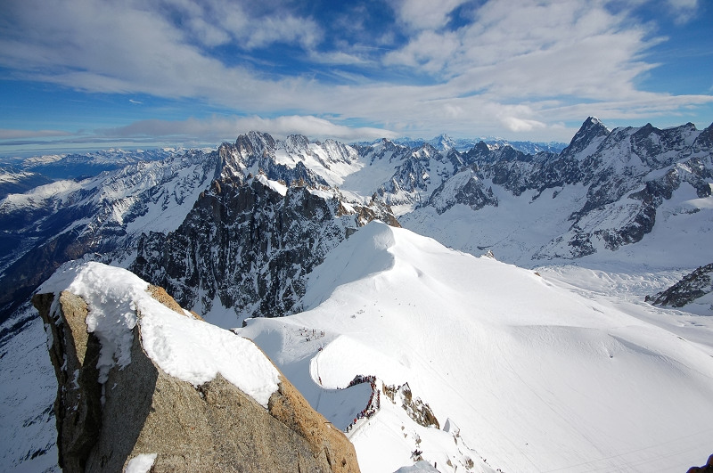

Slide 32
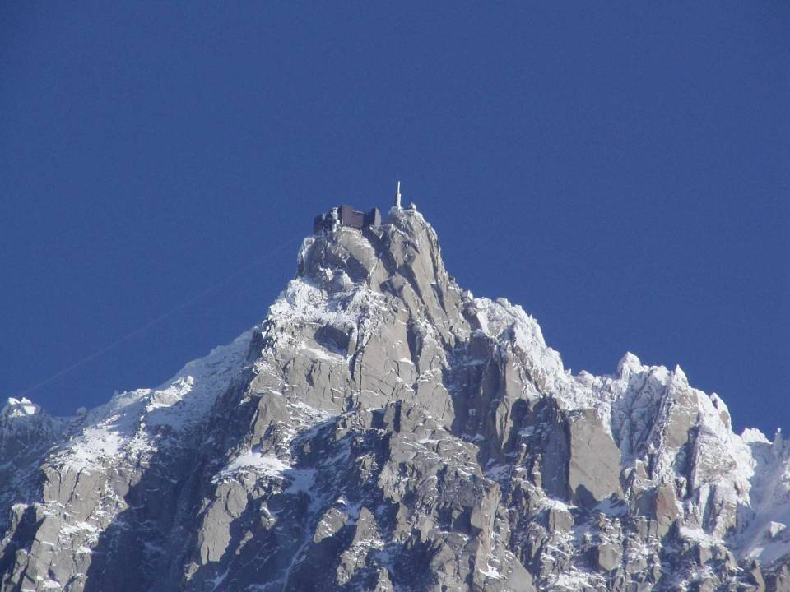

Slide 33
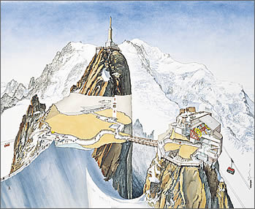
www.
laboutiquedelpowerpoint.
com
The End
EmmaDiamonds
Hasta Pronto!!!

